Slide 1

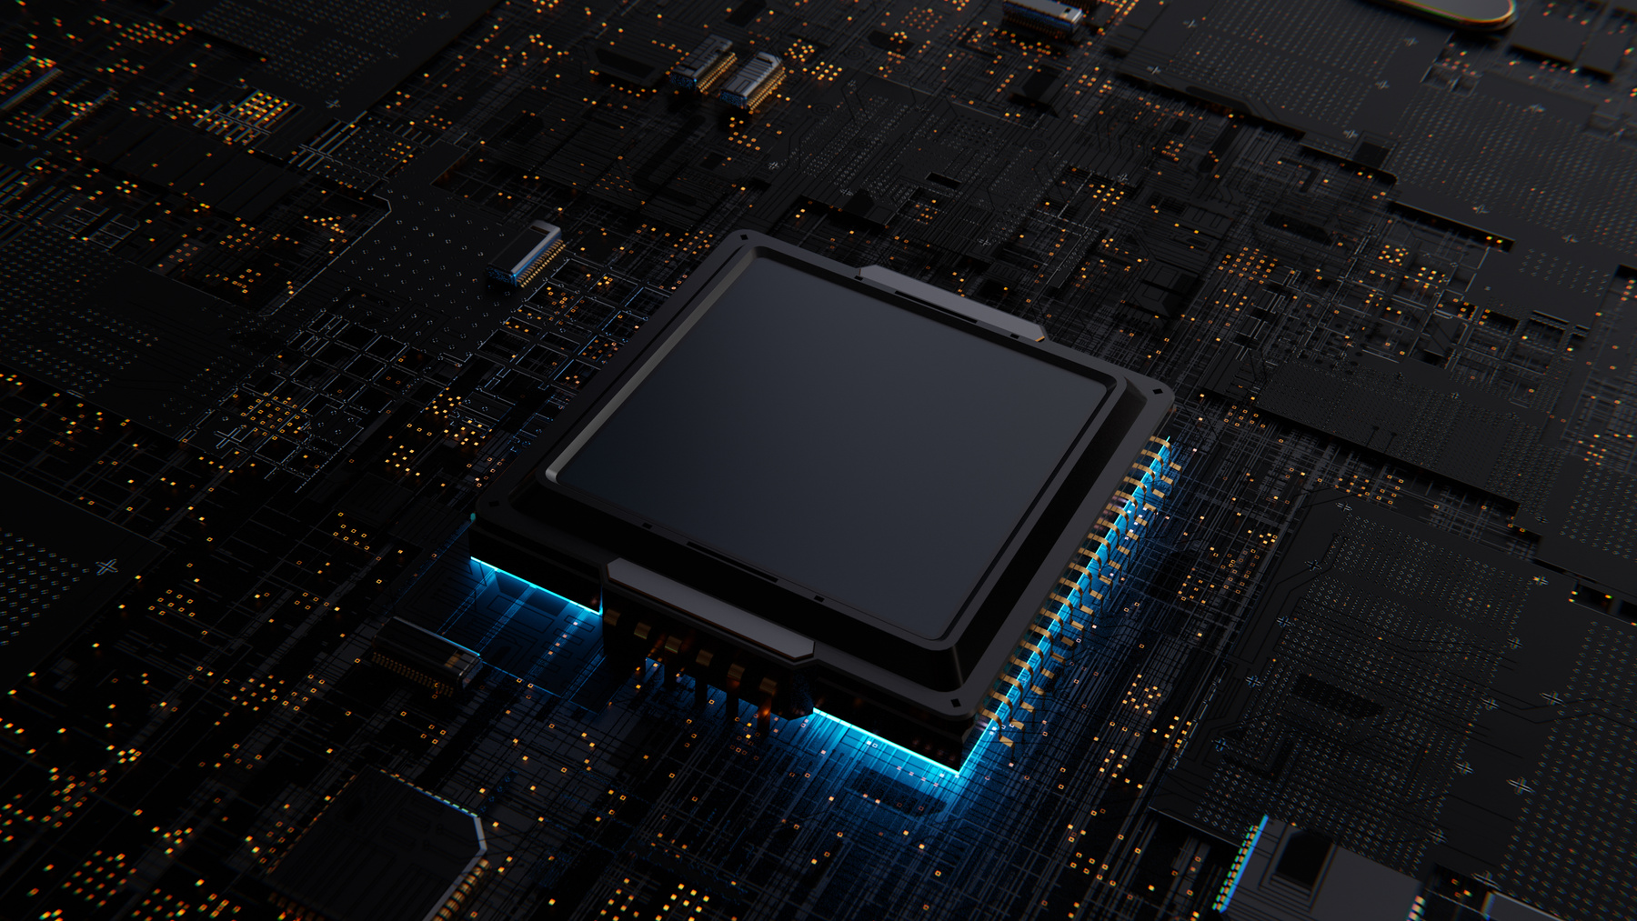
A Community Detection-Based Parallel Algorithm for Quantum Circuit Simulation
Presented By:
Umer Farooq
Irtaza Khan
Hussain Waseem

Slide 2
Why Simulate Quantum Circuits Classically ?
Current quantum hardware (NISQ era) is noisy and limited.
Classical simulations validate quantum algorithms and benchmark hardware.
Challenges:
Exponential memory growth with qubits (e.g., 50 qubits ≈ 9 PB).
High computational cost of tensor network contraction.

Slide 3

Tensor Networks & Quantum Circuits
Tensor Networks as a Solution
Represent quantum circuits as graphs:
Nodes = quantum gates (tensors)
Edges = qubits (indices)
Contraction : Merge tensors pairwise to compute amplitudes
Cost : Order of contraction impacts time/memory (NP-hard problem)

Slide 4
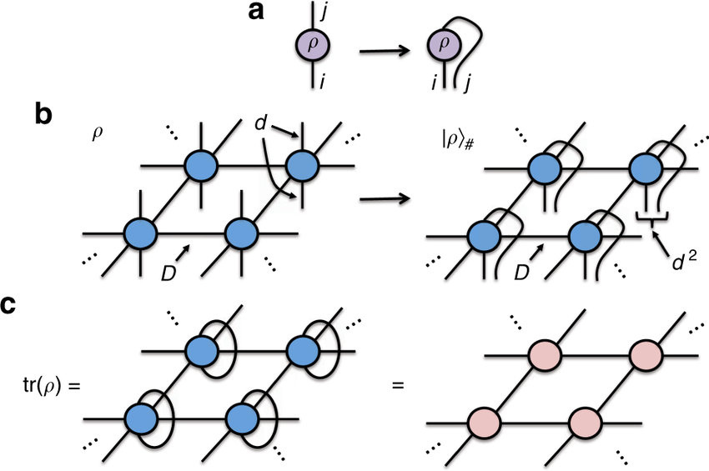
Diagram of a Tensor Network

Slide 5

Existing Parallelization Strategies
MPI with Slicing :
Slice indices to split the network → Contract sub-networks in parallel.
High communication overhead.
GPU-Based Contraction :
Parallelize tensor-pair contractions on GPU (e.g., cuTENSOR)
Limited by GPU memory and tensor ranks.
Limitation :
Spatial cost dominates for large circuits

Slide 6
Proposed Multistage Algorithm
Three Stages:
Key Innovation
Community Detection
Balances spatial and temporal costs via community-level parallelism.
Partition tensor network into weakly connected communities.
Community Detection
Parallel Community Contraction
Final Network Contraction
Parallel Community Contraction
Final Network Contraction
Contract communities in parallel (MPI/OpenMP).
Sequentially contract the reduced network.

Slide 7
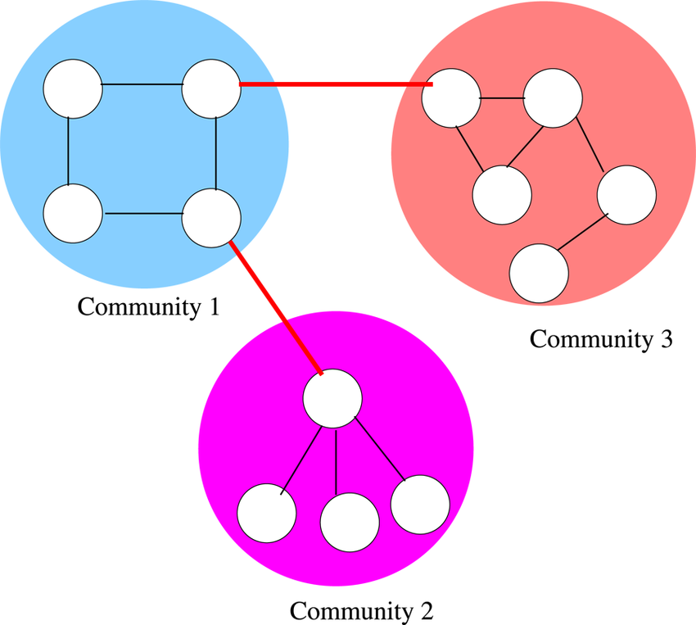
Girvan-Newman Algorithm
Steps :
Calculate edge betweenness centrality
Remove edges with highest centrality → Split into communities
Repeat until desired partitions
Advantages :
High-quality communities for tensor networks
Generates contraction plans automatically

Slide 8


Proposed Parallelization Strategy
Partition tensor graph with METIS
Distribute communities with MPI
Contract with OpenMP/OpenCL

Slide 9

Why METIS ?
Advantages Over Girvan-Newman
Faster for Larger Graphs.
Scalable for Distributed Systems.
Minimizes Edge Cuts

Slide 10
Expected Results
Comparison
Metrics:
Speedup: Tsequential​/Tparallel​.
Scalability: Strong vs. weak scaling.
Memory Efficiency: Reduced spatial cost.
Sequential vs. MPI + METIS vs. Hybrid
Speedup curves for QFT, RQC

Slide 11
Challenges & Mitigation
Challenges
Mitigation
Load imbalance
MPI communication overhead
GPU memory limits
METIS balancing constraints
Non-blocking MPI
Optimized OpenCL kernels

Slide 12
Conclusion
Hybrid parallelism + community detection reduces costs.
METIS enables scalable partitioning.

Slide 13
ANY QUESTIONS?

